Slide 1
Microarchitecture of Superscalar Processor
James E. Smith, Gurindar S. Sohi
24th October 2016
by, TEJESHWARA B M

Slide 2
Elements of High Performance Processing
Fetch multiple instructions.
Methods for determining true dependences, during execution.
Initiating, or issuing, multiple instructions in parallel.
Communicating data values through memory via load and store instructions.
Committing the process state in correct order.

Slide 3
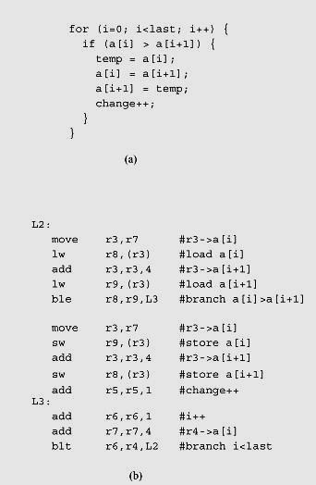
Control dependency constraints
When there is a conditional branch or jump, the program counter may be updated to a non-consecutive address. An instruction is said to be control dependent on its preceding dynamic instruction(s).
To overcome from control dependency, a method for is to predict the outcome of a conditional branch and speculatively fetch and execute instructions from the predicted path.

Slide 4
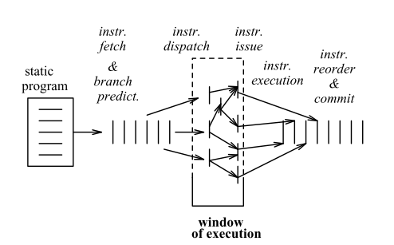
Speculative execution
means that some instructions may complete execution
when they would not have executed at all had the sequential model been followed
Architectural storage (the storage that is outwardly visible)
It cannot be updated immediately when instructions complete execution.
Rather, the results of an instruction must be held in a
temporary status until the architectural state can be updated.

Slide 5
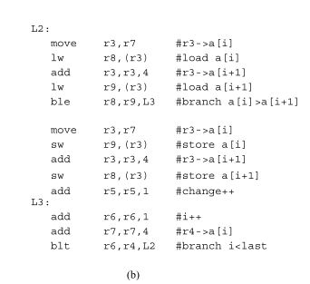
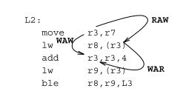
Data dependency constraints
TRUE dependency : RAW
Artificial dependency : WAW, WAR

Slide 6
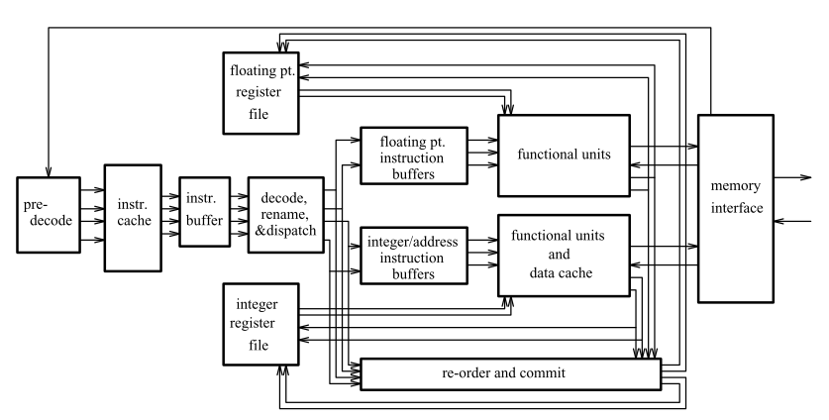
Organisation of Superscalar Processor

Slide 7
1. IF and Branch Prediction
:Stockpile :
An instruction buffer to hold a number of fetched instructions. The fetch mechanism can build up a "stockpile"
Instruction cache
Data cache
1. Recognizing conditional branches
pre-decode
2. Determining the branch outcome
static information : loops
dynamic information : branch history,
dynamic table, speculation
3. Computing branch targets
PC (uses offset value)
4. Transferring control
stockpile – mask the delay
buffers

Slide 8
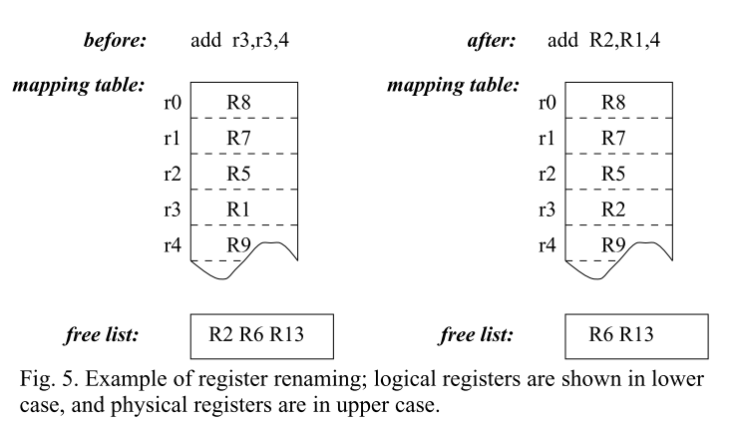
2. Decoding, Renaming & Dispatch
This phase includes detection of true data dependences
Resolution of other register hazards,
e.g. WAW and WAR

Slide 9
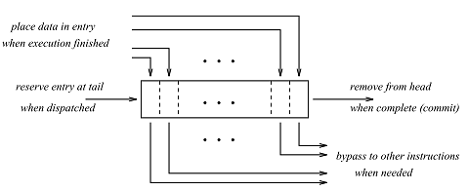
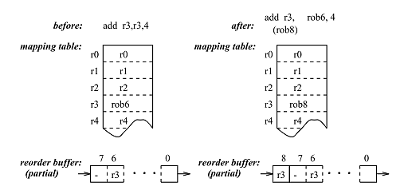
Register renaming
- logical register
- physical register
2. Reordered buffer
- FIFO
Register renaming eliminates artificial dependences due to WAW and WAR hazards.
Leaving only the true RAW register dependences.

Slide 10

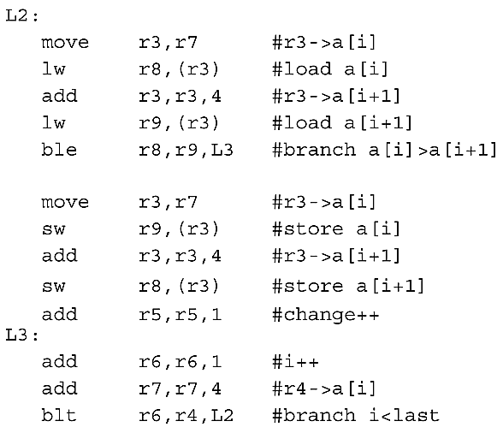
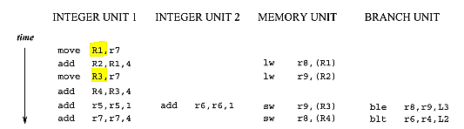
3. Instruction Issuing and Parallel Execution
Constraints:
Execution unit
Interconnect
Register ports
Issue buffer

Slide 11
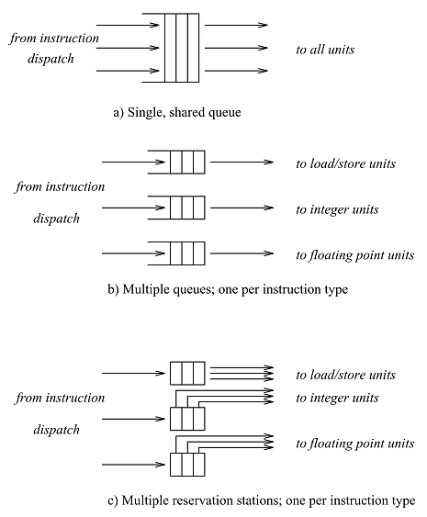
Single Queue Method
out-of-order issue
register renaming
reservation bits
Multiple queue Method
FP instruction Q
INT instruction Q
LD/ST instruction Q

Slide 12

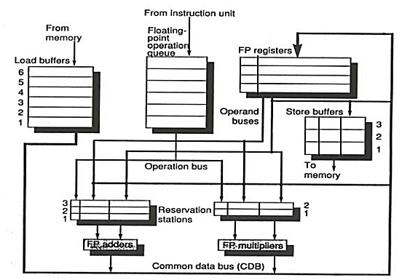
Reservation Stations
no strict FIFO
uses pointers instead of source data
Proposed in Tomasulo’s algorithm

Slide 13
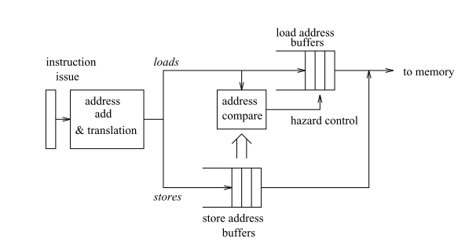
4. Handling Memory Operation
Address translation
Translation lookaside buffer (TLB)
Rename
Multiported
Store address buffer

Slide 14
5. Committing state
6. Role of Software
Sequential execution
Precise state
Techniques of recovery
Checkpoint/history buffer
Physical state
Logical/architectural state (reordered buffer, register renaming)
Software Scheduling
Group of instruction should issued more
Dependency of prev instruction should make minimum

Slide 15
MIPS R10000

Slide 16
 | MIPS R10000 | Alpha 21164 | AMD K5
Theme | 4 - way superscalar | 4 - way superscalar | variable length instruction
Pre-decode bits | 4 | 0 | 5
Branch prediction | resume cache | branch history entry (2 bits) | using pointers
Functional unit | 1 - address adder 1 - FP adder 1 - FP M/D/Sqrt 2 - interger ALU | 1 - FP adder 1 - FP Multiplier 2 - interger ALU | 1 - FP unit 1 - branch unit 2 - interger ALU 2 - LD/ST units
Features | * Branch snapshot * physical reg = 2 x Logical reg * exception handling - reorderbuffer * 4 commits at a time | * high clock rate * miss address file(MAF) - 6 entry * Bypass in reorderbuffer * No out-of-order

Slide 17
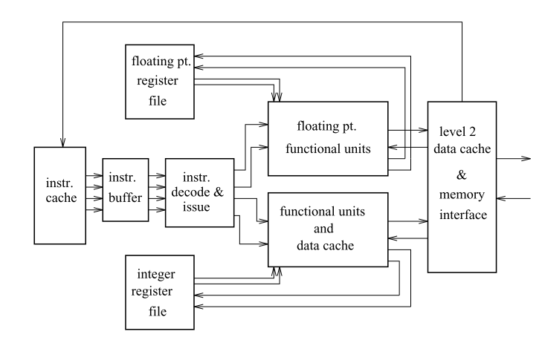
Alpha 21164

Slide 18
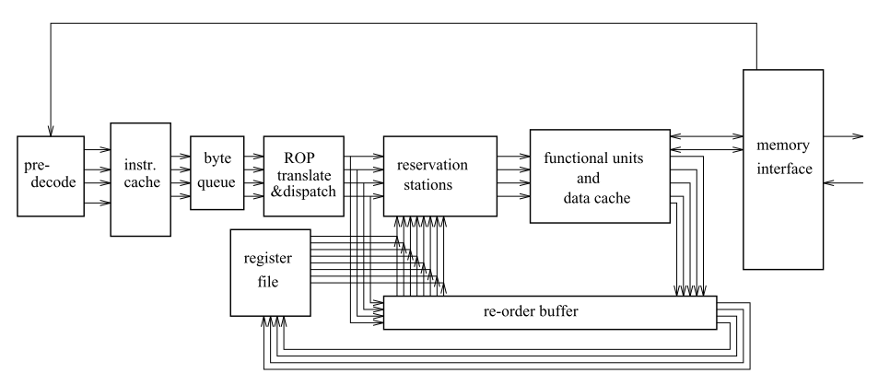
AMD K5

Slide 19
Conclusion
Limitation
Conditional branches
Complexity in simultaneous issuing instruction
Gap btw processor & main memory
Sophisticated data cache
Better cache prefetch method
More developed memory hierarchy
Memory chip design
8-way superscalar

Slide 20
What next ….?
VLIW : It’s collection of several independent operations, which can all be executed in parallel.
s/w being responsible for analysing dependency & creating execution schedule.
Hardware utilisation is lesser & simpler to implement.
Multiprocessor
Inter processor synchronization & communication overhead extremely low.
Flow control mechanism.

Slide 21
THANK YOU

